Slide 1
Hindu Pilgrimage Spots in India
Allahabad
Allahabad, sacred city of Hinduism was formerly called 'Prayag' in commemoration of a sacrifice done by Lord Brahma.
It is best known as host to the mind-boggling number of Kumbh pilgrims who visit this endearing city every 12 years.
The land being surrounded by these 3 rivers, the Ganga, the Yamuna, and the mythical Sarswati
Location: Uttar Pradesh
Attractions: Kumbh Mela, Sangam Bath, Ardh Kumbh
Attraction
Kumbh Mela (Allahabad Pilgrimage)
One of the largest congregations of devout Hindus from all over the world, the Kumbh Mela is held once every 12 years, on the banks of the Sangam. A holy dip in the sacred waters, and offerings to the Sun-God, are believed to cleanse the soul.

Slide 2
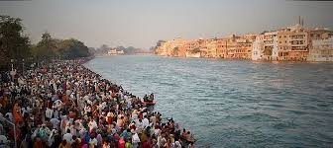
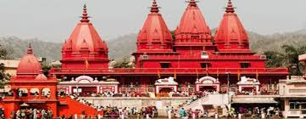

Slide 3
2. Amarnath
Amarnath is 145 km east of Srinagar in Kashmir.
Each year on the full moon day of July-August (Sravana) when the Siva-linga attains its maximum height(6 ft) there is a festival at this cave temple.
AmarnathYatra The of the most important event during July/ August, is Amarnath Yatra to the Holy Pilgrimage.
This is an annual event when thousands of Hindus from different corners of the Globe visit Amarnath caves. The pilgrims trek from Pahalgam to these caves and worship the great ice Lingam
Location: 145-km From Srinagar, Kashmir Region
Altitude: 4,175m (13,700ft). Darshan Season: July To August

Slide 4
